Slide 1
Ions
February 2017

Slide 2
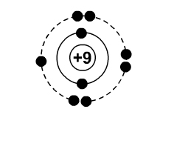
Atoms
Are neutral because the number of protons = the number of ______
That is, the positives (+) = the negatives (-)

Slide 3
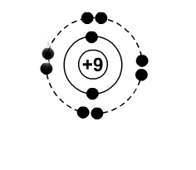
What happens if an atom gains an electron?
It becomes a _____ ion.
_________ gain electrons.

Slide 4
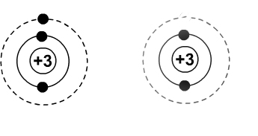
What happens if an atom loses an electron?
It becomes a _____ ion.
_______ lose electrons

Slide 5
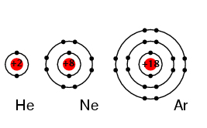
Metal atoms _____ electrons until they look like a noble gas.
Non-metals ____ electrons until they look like a noble gas.
Be Al
O P

Slide 7
Symbols of Ions
Metals
Non-metals
For every electron that a metal loses it gains a _____ charge
Lithium loses 1 electron and becomes Li⁺
Magnesium loses 2 electrons and becomes Mg²⁺
For every electron that a non-metal gains it gains a _____ charge
F gains 1 electron and becomes F⁻
Nitrogen gains 3 electrons and becomes N³⁻

