Slide 1
Safety in the Lab
SNC2P
February 2017

Slide 2
RULE #1: Make sure that you know what to do before you do it. Ask any questions BEFORE you begin.

Slide 3

RULE #2: Do not taste, eat, drink, or inhale anything we use in science.

Slide 4

RULE #3:If instructed to do so, wave the smell of chemicals toward you.

Slide 5

RULE #4: Do not eat food or drink in the lab area.

Slide 6
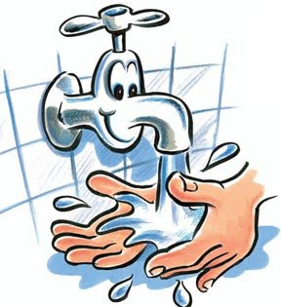
RULE #5: When working with chemicals, keep your hands away from your face. Wash your hands after all science activities.

Slide 7
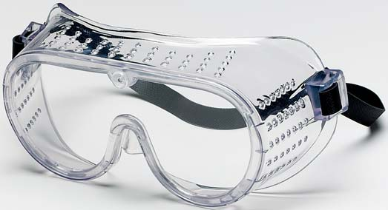
RULE #6: Always wear safety goggles when working with chemicals.

Slide 8
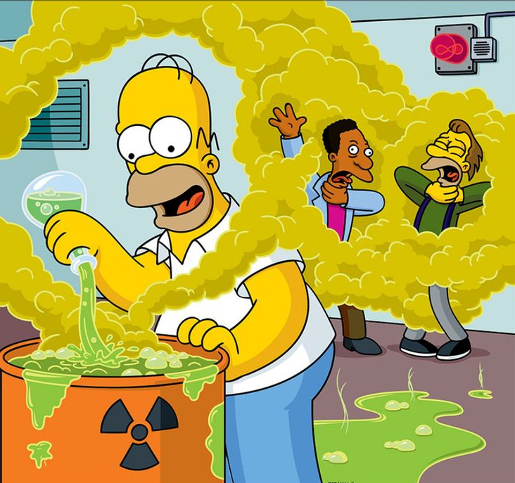
RULE #7: Do not mix unknown chemicals just to see what happens.

Slide 9
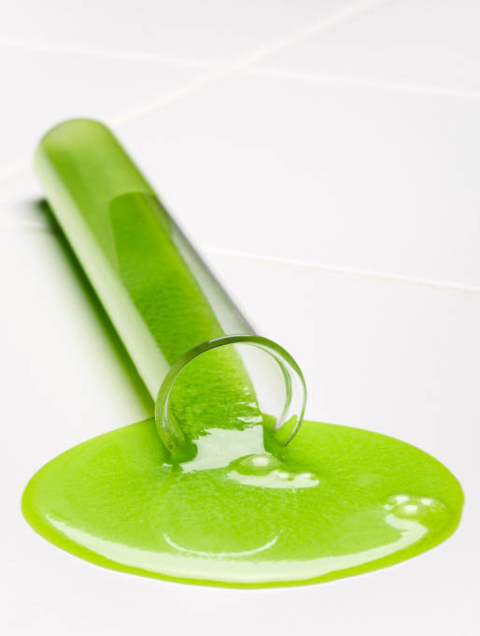
RULE #8: Clean up all spills and report any accidents to the teacher.

Slide 10
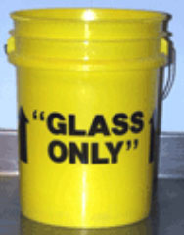
RULE #9: Use a broom and dustpan to pick up any broken glass and place the broke glass in the broken glass container.

Slide 11
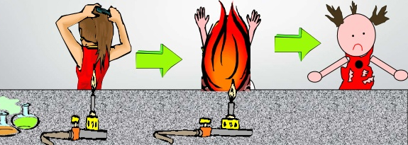
RULE #10: When using a Bunsen burner tie back long hair and roll up loose sleeves. Never reach across a flame.

Slide 12
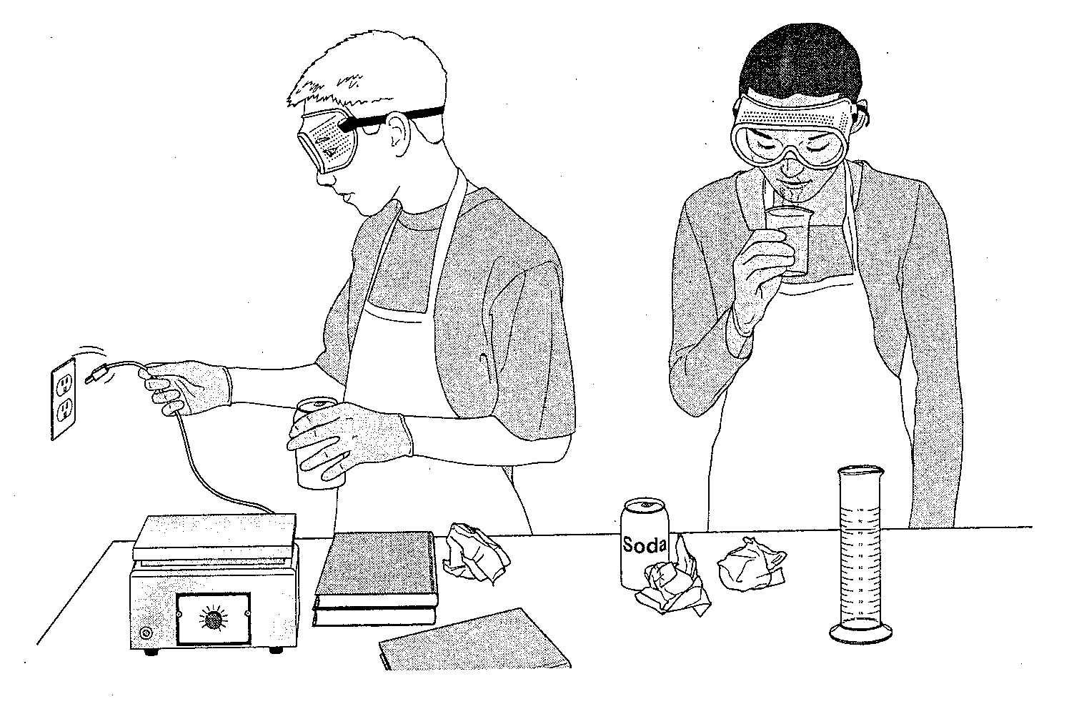
What’s Wrong With This Picture?

Slide 13
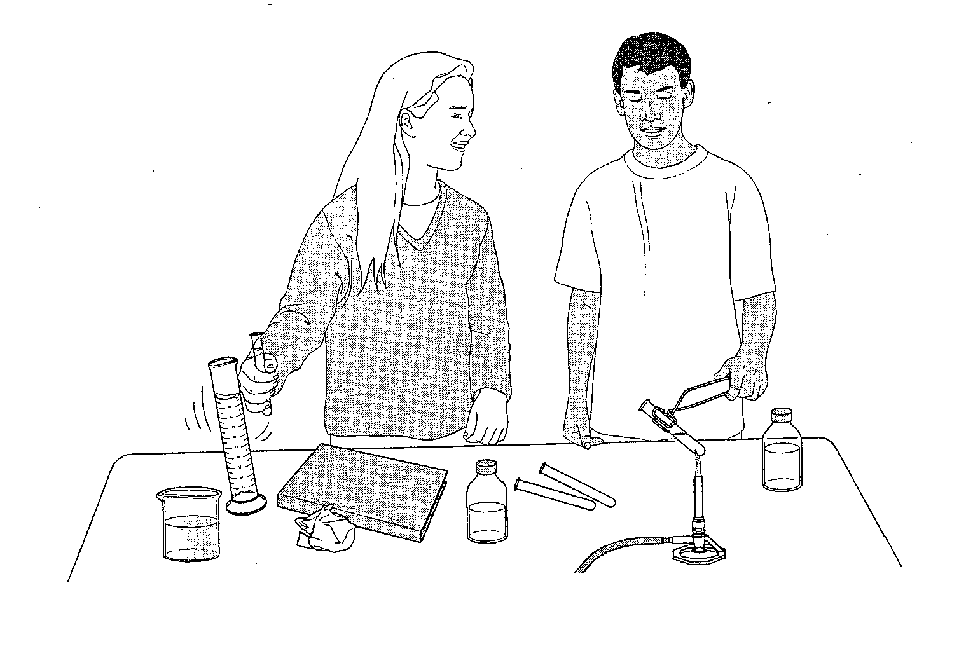
What’s Wrong With This Picture?

Slide 14
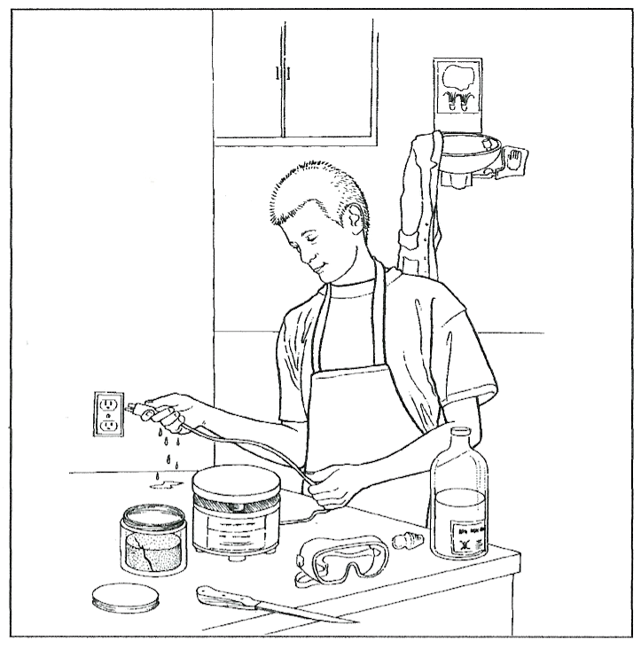
What’s Wrong With This Picture?

