Slide 1
Buffers
December 2016

Slide 2
A buffer solution….
Contains similar concentrations of a weak acid and its conjugate base (or weak base and its conjugate acid)
For example: 0.10M HF and 0.10M NaF
OR
0.50M NH₃ and 0.40M NH₄Cl

Slide 3
A buffer solution…. Is a special case of the common ion effect since the conjugate base (or acid) is present BEFORE the ionization of the acid (or base) occurs
HF_{(aq)} + H₂O ←→ F⁻_{(aq)} + H₃O⁺_{(aq)}
[I] 0.10 0.10 0
[C] -x +x +x
[E] 0.10 – x 0.10 + x x
Why are both “–x” and “+ x” insignificant?
What is the pH of this buffer solution?

Slide 4
What is the pH of the 0.50M NH₃/0.40M NH₄Cl buffer?
NH₃ _{(aq)} + H₂O ←→ OH⁻_{(aq)} + NH₄⁺_{(aq)}
[E] 0.50 - x x 0.40 + x

Slide 5
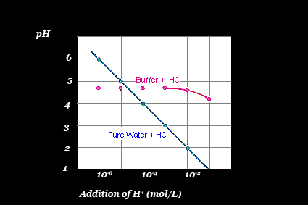
A buffer solution…. Maintains a nearly constant pH even when additional H₃O⁺ or OH⁻ is added to it

Slide 6
How does a buffer maintain a constant pH?
Adding H₃O⁺ to the buffer:
HF_{(aq)} + H₂O ←→ F⁻_{(aq)} + H₃O⁺_{(aq)}
[E] 0.10 0.10 7.2x10⁻⁴
Stress +0.010
[C] +0.010* -0.010* -0.010
[E] 0.11 0.090 x
*there is an excessive amount of F⁻ present (compared to a 0.10M HF solution) to allow for the almost complete removal of the stress
What is the new pH?

Slide 7
How does a buffer maintain a constant pH?
Adding 0.01M OH⁻ to the buffer:
HF_{(aq)} + H₂O ←→ F⁻_{(aq)} + H₃O⁺_{(aq)}
[E] 0.10 0.10 7.2x10⁻⁴
Stress -0.010 *
[C] -0.010 +0.010 +0.010
[E] 0.090 0.11 x
*the addition of the OH⁻ continues to remove the H₃O⁺ until it has all been turned into H₂O – but not to worry… there is PLENTY of HF available to ionize!
What is the new pH?

Slide 8
A buffer solution…. Can be created to maintain any pH by choosing an appropriate acid/base pair as well as the ratio of acid to base
What is the pH of:
0.40M Acetic acid/0.40M sodium acetate?
0.10M acetic acid/0.50M sodium acetate?
0.10M hydrocyanic acid/0.10M sodium cyanide?
0.10M hydrogen carbonate/0.10M carbonate?
5.60 g of nitrous acid and 4.75 g of sodium nitrite

Slide 9
A buffer solution is… Is most effective at maintaining a pH value that is close to the value of its pK_{a}
pK_{a} = -log(K_{a})
In other words, when the [acid] = [conjugate base]

Slide 10
Biological applications:
Blood plasma pH 7.4 maintained by carbonic acid/hydrogen carbonate.
The [HCO₃⁻] is about 20x that of [H₂CO₃]
The [H₂CO₃] is controlled by respiration
The [HCO₃] is controlled by the kidneys

Slide 11
Biological applications:
2) Internal cellular fluid pH 6.9-7.4 in mammals maintained by dihydrogen phosphate/hydrogen phosphate

Slide 12
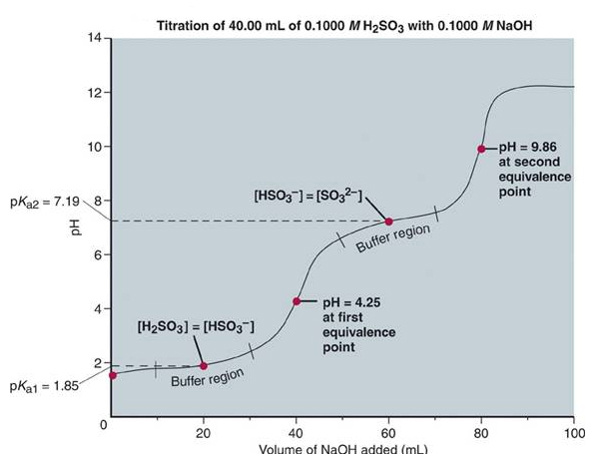
Buffers and Titration Curves

Slide 13
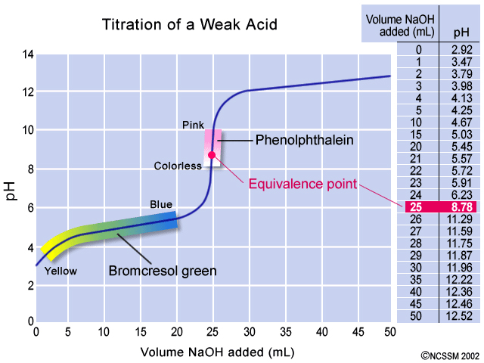
What is the K_{a} of the weak acid below?

Slide 14
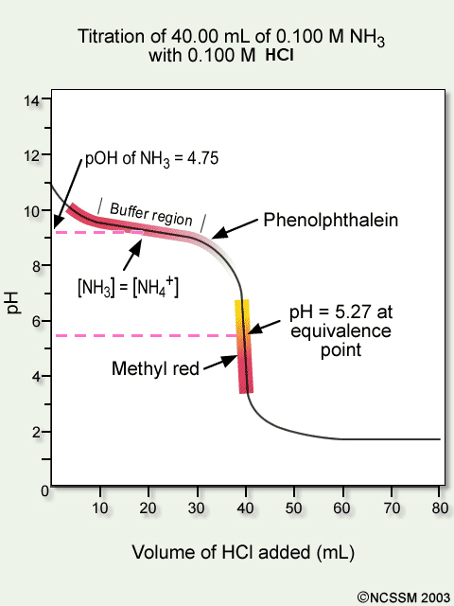
What is K_{b} of the weak base below?

