Slide 1
Titration Curves
December 2015

Slide 2
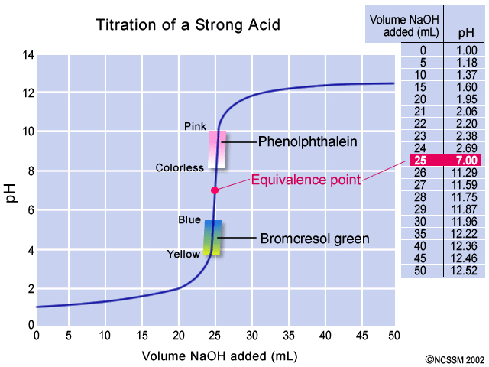
Strong Acid and Strong Base

Slide 3
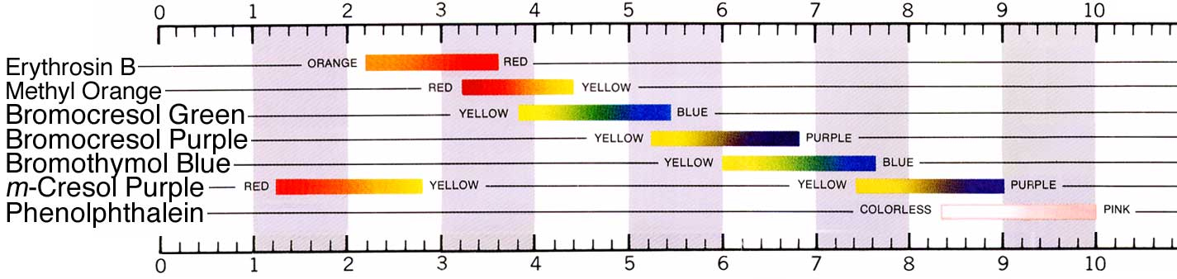
Acid Base Indicators

Slide 4
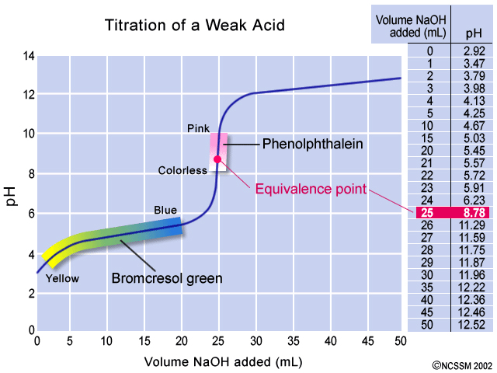
Weak Acid and Strong Base

Slide 5
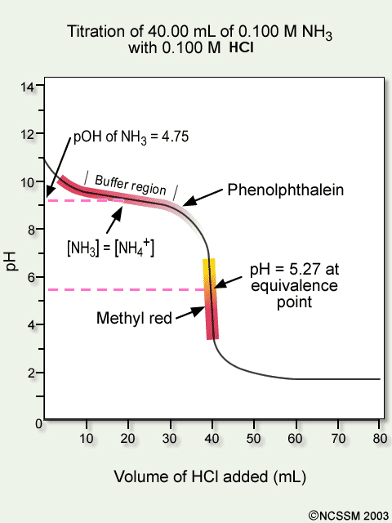
Weak Base and Strong Acid

Slide 6
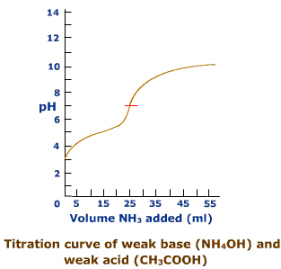
Weak Acid and Weak Base

Slide 7
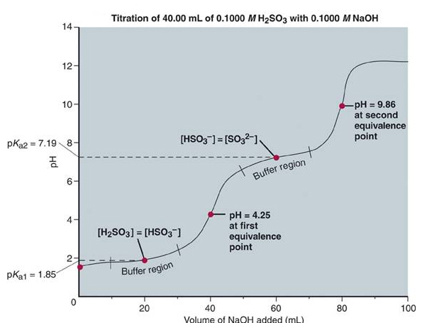
Polyprotic Acid and Strong Base

Slide 8
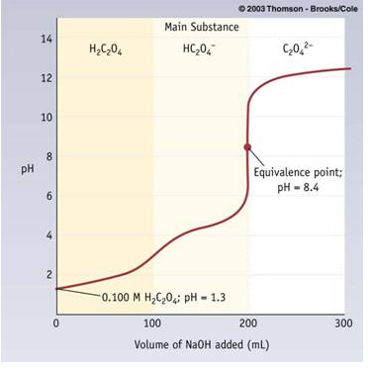
Oxalic acid and sodium hydroxide

