Slide 1
Intermolecular Forces
aka
VanderWaals Forces

Slide 2
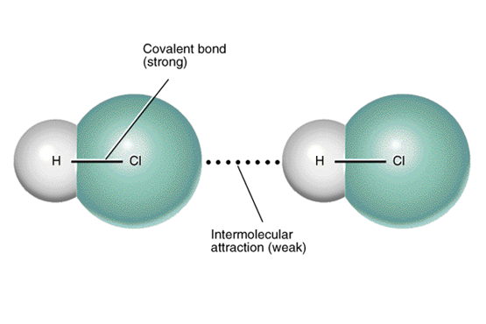
Are the forces of attraction between one molecule and the next

Slide 3
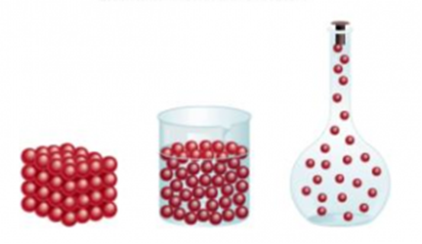
Solids: Intermolecular forces hold molecules together in a fixed arrangement
Liquids: Intermolecular forces hold molecules in a less orderly arrangement
Gases: No intermolecular forces at work between molecules

Slide 4
Boiling point
the temperature at which a liquid turns into a gas
the heat required to boil a substance is used to break the intermolecular forces
the higher the boiling point, the _________________ the intermolecular forces at work in a substance
therefore boiling points reveal the strength of intermolecular forces at work in a substance
We can use this idea to predict relative boiling points

Slide 5
Types of VanderWaals forces :
1) Dipole- dipole force
2) London force (aka dispersion force)
3)Hydrogen bonding

Slide 6
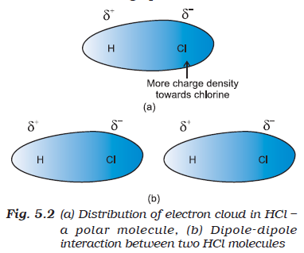
1) Dipole-dipole force
Exist only between polar molecules

Slide 7
Which has the stronger dipole-dipole force in each pair?
NH₃ or NBr₃
CO₂ or SO₂
3) H₂O or OF₂
4) HI or HCl

Slide 8
2) London force
Is the force acting between all molecules – both polar and non-polar
Is the only force acting between non-polar molecules
Fritz London (1920) suggested that a temporary, very short-lived dipole existed in non-polar molecules
How? Electrons in a molecule are continually in motion. As they shift position around the nucleus, they create temporary slightly positive and slightly negative ends.
This induces the next molecule to do the same thereby setting up a weak, temporary dipole-dipole force

Slide 9
London force
Strength is dependent on the number of electrons in a molecule
i.e. the greater the number of electrons, the greater the impact that their movement has on neighbouring molecules

Slide 10
Which has the stronger London force in each pair?
CO₂ or CS₂
I₂ or F₂
PH₃ or NF₃

Slide 11
Two factors influence the strength of the IMF acting between molecules of a substance and therefore its boiling point
The 2 factors to consider are:
The polarity of the molecule
The total number of electrons in the molecule

Slide 12
We can predict/compare the relative boiling points of two molecules as long as:
The two molecules have the same number of electrons
OR
The two molecules have the same polarity
OR
Both factors are influencing the bpt in the same way (i.e. not opposing each other)

Slide 13
Which has the higher bpt in each pair?
H₂ or F₂
Br₂ or ICl
CO₂ or CS₂
NF₃ or Cl₂O

Slide 14
Predict the bpt of HF given:
Bpt of HI = -34ºC
Bpt of HBr = -66ºC
Bpt of HCl = -85ºC
Bpt of HF = ___ºC
19.5

Slide 15
Why is the boiling point of HF so high?
The boiling point of HF is far higher than predicted because it has a special type of IMF at work between its molecules

Slide 16
3) Hydrogen bonding
A special type of dipole-dipole
Exists between molecules that contain H-O bonds, H-F bonds or H-N bonds
Stronger than a typical dipole-dipole force

Slide 17
What is so special about H-F, H-O and H-N bonds?
F, O and N are the most electronegative
F, O and N have lone pairs of electrons that are confined to a small volume of space compared to the other elements in their family allowing for a high density of negative charge
H’s 1 electron is highly attracted to F,O and N leaving H’s proton virtually unprotected

Slide 18
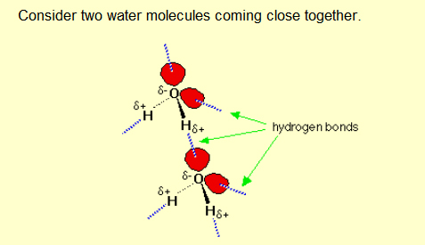

Slide 19
Which has the stronger Hydrogen bonds?
H₂O or HF
NH₃ or H₂O

Slide 20
Which has the higher bpt?
NH₃ or H₂O
H₂O or H₂O₂
H₂O or HF

Slide 21
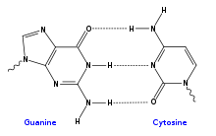
Hydrogen bonding in DNA

