Slide 1
Shapes of Molecules
December 2014

Slide 2


Linear: AX or AX₂
AX: No lone pairs
AX₂: No lone pairs

Slide 3

Trigonal Planar: AX₃ -no lone pairs

Slide 4
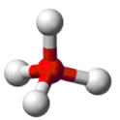
Tetrahedron: AX₄ – no lone pairs

Slide 5

Trigonal Pyramid: AX₃ – 1 lone pair

Slide 6


Bent or V-shape: AX₂
1 lone pair
2 lone pairs

Slide 7
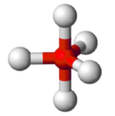
Trigonal Bipyramidal: AX₅ – no lone pairs

Slide 8
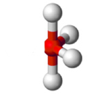

Seesaw: AX₄ – 1 lone pair

Slide 9
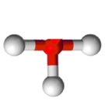
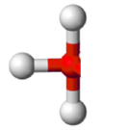
T-shaped: AX₃ – 2 lone pairs

Slide 10

Linear: AX₂ – 3 lone pairs

Slide 11
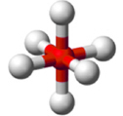
Octahedron: AX₆ - no lone pairs

Slide 12

Square Pyramid: AX₅ – 1 lone pair

Slide 13

Square Planar: AX₄ – 2 lone pairs

