Slide 1
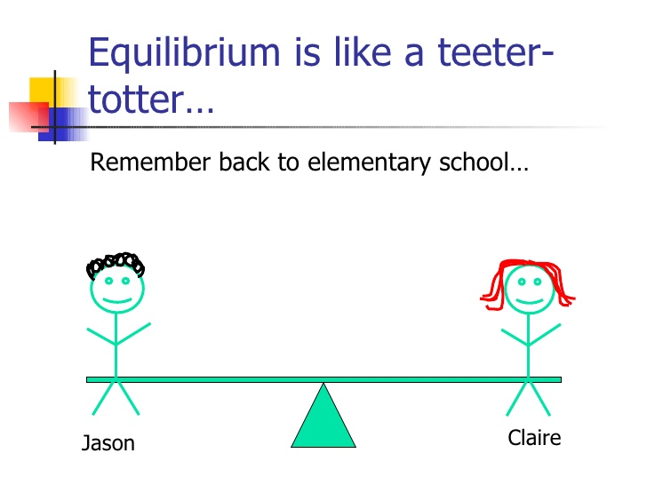
Equilibrium and Le Chaletier’s Principle

Slide 2
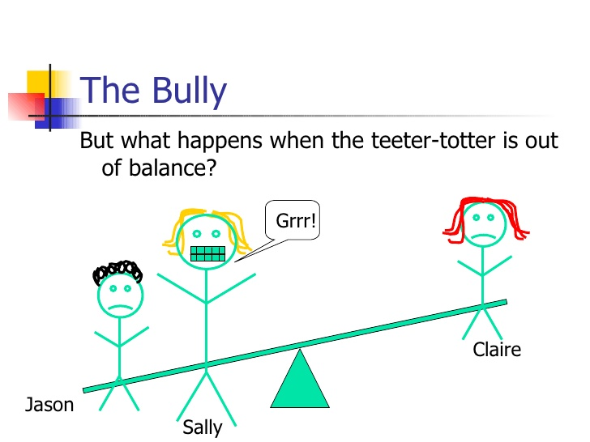
Stressing an Equilibrium System

Slide 3
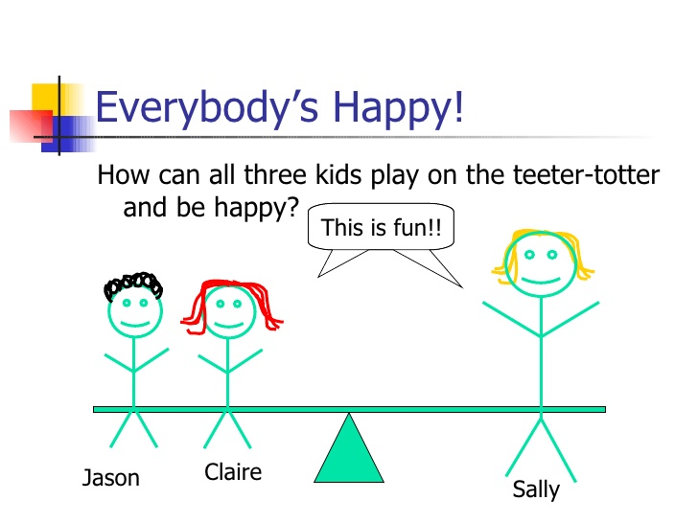
Restoring Equilibrium

Slide 4
Le Chatelier’s Principle
When a system at equilibrium is stressed (disturbed)
the system will correct itself to restore equilibrium

Slide 5
What are stresses (disturbances)?
Changes in the concentration of either one of the products or reactants
Changes in volume or pressure of systems that involve gases
Changes in temperature
(Adding a catalyst is not considered a stress)

Slide 6
How does the principle work?
The system starts at equilibrium
A stress is applied to the system
The system responds to the stress by either shifting to the right (makes more ______) or the left (makes more _________) to restore a new equilibrium

Slide 7
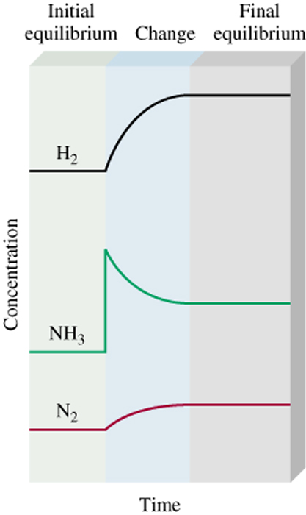
Consider the following reaction:
N_{2(g)} + 3H_{2(g)} ←→ 2NH_{3(g)}
1) The system is at equilibrium
Q? What evidence is there to support this?
2) NH₃ is added to the system
Q? What evidence is there to support this?
3) The system responds by
Reacting __________
This causes the concentration of H₂ and N₂ to _____
The position of equilibrium has shifted to the ______

Slide 8
Predict the response of the system for each of the following stresses:
N_{2(g)} + 3H_{2(g)} ←→ 2NH_{3(g)}
Removing some NH₃
Adding some N₂ or H₂
Removing some N₂ or H₂
Conclusion:
The system will shift left when:
The system will shift right when:

Slide 9
Changes in pressure
Pressure is caused by gas molecules hitting the sides of their container.
The more molecules you have in the container, the higher the pressure will be.
Pressure can increase or decrease by changing the volume of the container
Decreasing the volume of the container _______ the pressure; increasing the volume _____ the pressure
The system can reduce the pressure by reacting in such a way as to produce fewer molecules.

Slide 10
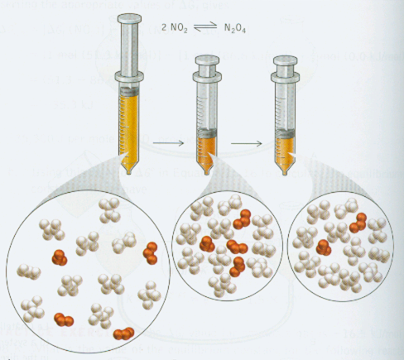
2NO_{2(g)} ↔ N₂O_{4(g)} Brown colourless
Chemistry; The Science
in Context;by Thomas
R. Gilbert, Rein V.
Kirss, and Geoffrey
Davies, Norton
Publisher, 2004, p 752

Slide 11
Le Châtelier’s Principle
Changes in Volume and Pressure
A (g) + B (g) C (g)
Change
Shifts the Equilibrium
Increase pressure
Side with fewest moles of gas
Decrease pressure
Side with most moles of gas
Increase volume
Side with most moles of gas
Decrease volume
Side with fewest moles of gas
14.5

Slide 12
What impact will increasing pressure have on the following?
2H_{2(g)} + O_{2(g)} ←→ 2H₂O_{(g)}
2NaHCO_{3(s)} ←→ Na₂O_{(s)} +H₂O_{(l)} + CO_{2(g)}
A_{(g)} + B_{(g)} ←→ C_{(g)} + D_{(g)}

Slide 13
Changes in temperature
If we consider heat as a product in the following reaction:
A + B ←→ C + heat
If increasing the temperature of a system is like increasing “concentration” of the heat,
then increasing the temperature will shift the equilibrium to the ________
and decreasing the temperature will shift the equilibrium to the _______.
What happens if the heat term is on the reactant side?

Slide 14
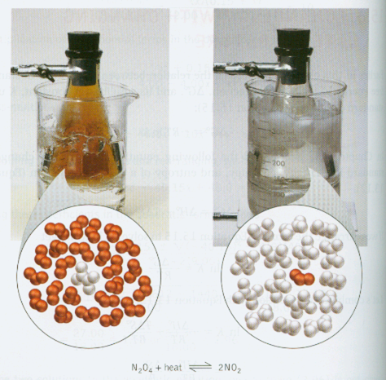
Le Châtelier’s Principle; Temperature Effect
Chemistry; The Science
in Context;by Thomas
R. Gilbert, Rein V.
Kirss, and Geoffrey
Davies, Norton
Publisher, 2004, p 764

Slide 15
K_{eq} is temperature dependent
What effect does an increase in temperature have on K_{eq}?
It depends on which side the heat term is written.
Consider A + B ←→ C + heat
Increasing temperature causes [C] to ____ and [A] and [B] to _____
What effect does this have on K_{eq}?
What effect does a decrease in temperature have on K_{eq}?
How do these changes in temperature effect K_{eq} for the reaction: A + B + heat ←→ C?

