Slide 1
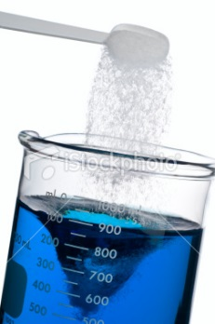
Solutions and Solubility

Slide 2
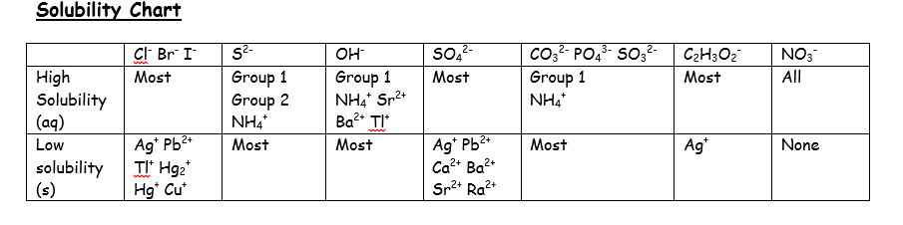
Solubility: can be described qualitatively

Slide 3
Solubility: can be described quantitatively
The maximum amount of solute that can be dissolved in a given volume of solution
g/100 mL OR g/L OR mol/L (molar solubility)
Depends on the solute being dissolved AND the temperature

Slide 4
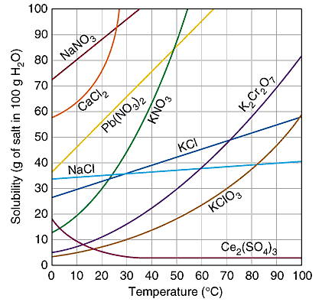
Solubility of various ionic compounds

Slide 5
What is the solubility of KClO₃ at 30ºC
in g/100 mL?
b) in moles/L?

Slide 6
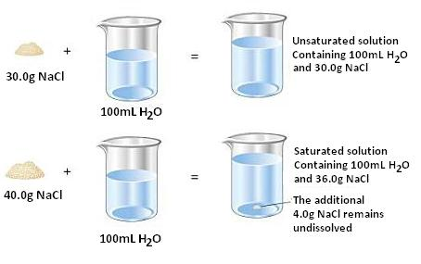
Saturated vs. unsaturated solutions

Slide 7
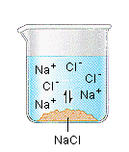
Consider the saturated solution of NaCl on the previous slide.
We can represent the solution on the right as follows:
NaCl_{(s)} ←→ Na⁺_{(aq)} + Cl⁻_{(aq)}
When the maximum amount of NaCl dissolves, the solution will be saturated and will reach equilibrium

Slide 8
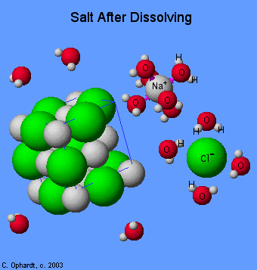
Recall how NaCl dissolves in polar water

Slide 9
Equilibrium plays a more important role with insoluble or slightly soluble compounds
Consider CaF₂ which is considered to be a slightly soluble compound.
Write the equation that represents a saturated solution of CaF₂.
Write the equilibrium expression.
Notice that the solid is not included in the expression. We no longer call this K_{eq} but K_{sp} (solubility product constant).

Slide 10
Write the equation for saturated solutions of the following compounds and look up their K_{sp}value.
BaSO₄
PbI₂
Sr₃(PO₄)₂

Slide 11
Solubility and ICE Charts
BaSO_{4(s)} ←→ Ba²⁺_{(aq)} + SO₄²⁻_{(aq)}
_{What is the [Ba}²⁺ ]?
_{What} _{is} _{the} _{solubility} _{of} _{BaSO4} _{in} _{mol/L?} _{In} _{g/L?} _{In} _{g/100 mL?}

Slide 12
Solubility and ICE Charts
What is the molar solubility of PbI₂ ? Sr₃(PO₄)₂ ?

