Slide 1
The Cause of Chemical Change

Slide 2
Spontaneous Reactions:
A reaction is said to be spontaneous if, after being given the necessary energy to begin the reaction (activation energy), it occurs without continuous outside assistance
In other words, if reactants react then the reaction is spontaneous

Slide 3
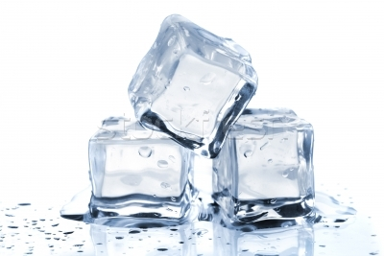
Examples of spontaneous reactions
Melting ice
Spontaneous under right conditions

Slide 4
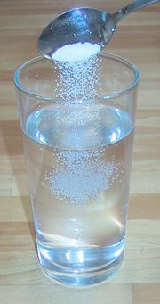
Dissolving sodium chloride
NaCl_{(s)} → Na⁺_{(aq)} + Cl⁻_{(aq)}+ heat

Slide 5
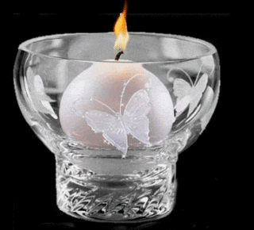
Burning a candle
Needs an initial spark to get started

Slide 6
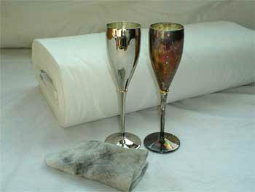
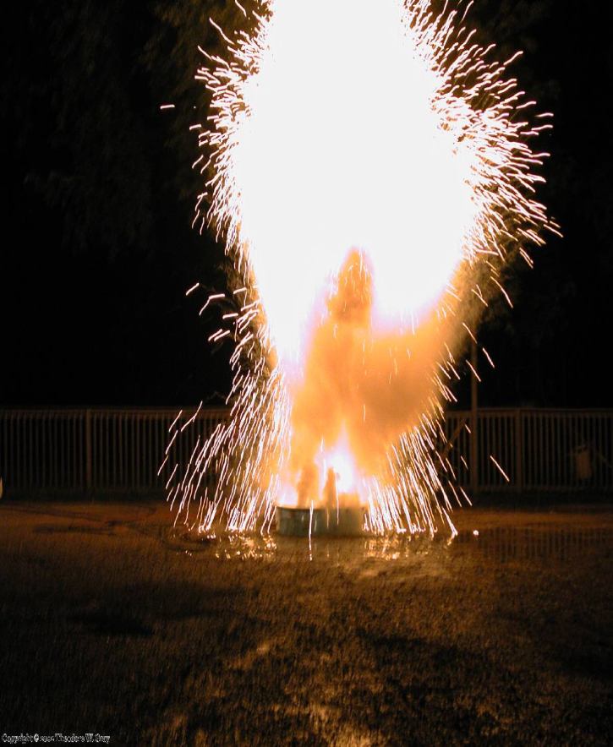
Spontaneous reactions can be very rapid or very slow
Silver tarnishing Cesium in water

Slide 7
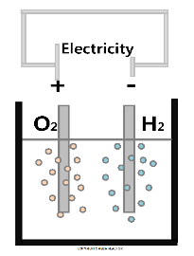
Examples of non-spontaneous reactions
Decomposition of water – needs a continuous supply of energy or the reaction will stop

Slide 8
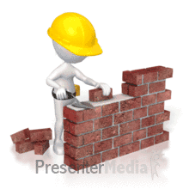
Building a brick wall
Needs the builder to keep working or the wall will stop being made

Slide 9
Non-spontaneous reactions occur at the expense of a previous spontaneous reaction
The reaction creating the electricity is spontaneous but the decomposition of water is not
The energy the brick layer is using is spontaneous but the building of the wall is not

Slide 10
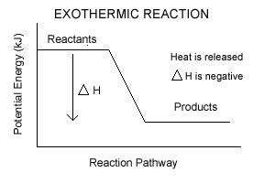
Spontaneous reactions tend to be exothermic. (i.e. they involve a loss in energy)
Products are more stable than reactants – this is why the reaction occurs

Slide 11
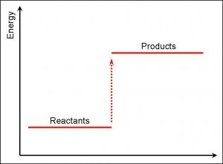
Why do endothermic reactions occur (i.e. melting ice) if products are less stable than the reactants?

Slide 12
More than enthalpy change must be responsible for the spontaneity of a reaction
Spontaneous reactions depend on :
Enthalpy
Entropy

Slide 13
Entropy (S)
is a measure of the randomness or disorder of a system
Every chemical and physical change involves a change in the randomness or entropy of the system.

Slide 14
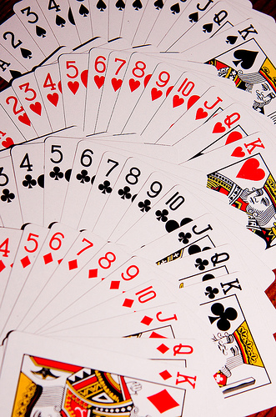
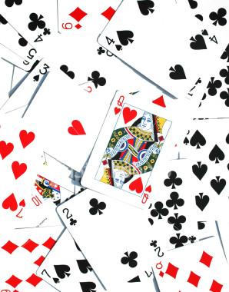
Throwing a new deck of cards in the air
Low entropy High entropy

Slide 15
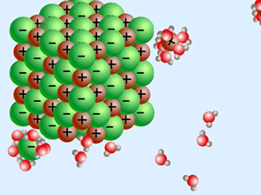
Dissolving sodium chloride in water
Solid NaCl low entropy Aqueous NaCl high entropy

Slide 16
Spontaneous reactions and entropy
Spontaneous reactions tend to have an increase in entropy
i.e. S_{i} < S_{f} OR ΔS > 0

Slide 17
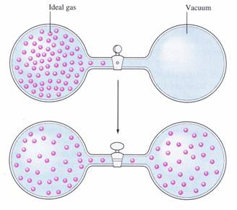
Entropy increases when:
The volume of a gaseous system increases

Slide 18
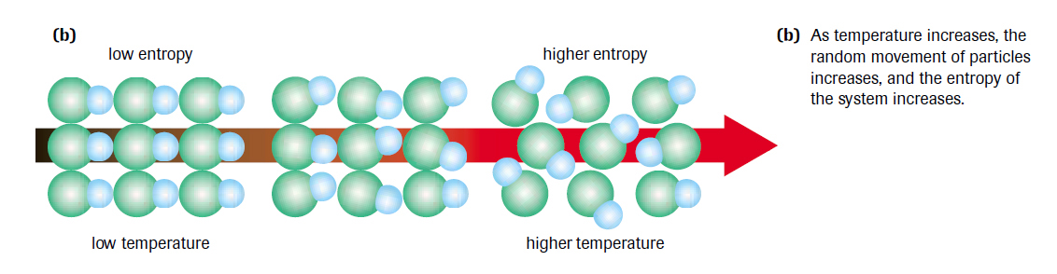
2) The temperature of a system increases

Slide 19
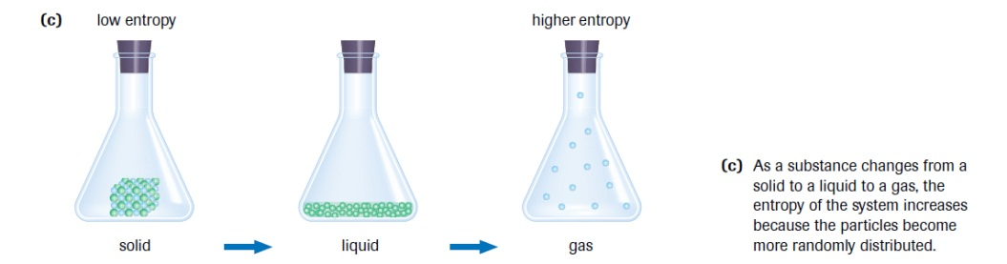
3) The physical state of the system changes

Slide 20
4) When the n_{product} > n_{reactant}
2NH_{3(g)} → N_{2(g)} + 3H_{2(g)}

Slide 21
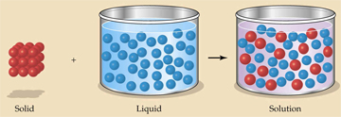
5) A solid dissolves

Slide 22
6) solid reactants become liquid or gaseous products (or liquids become gases)
2NaHCO_{3(s)} → Na₂O_{(s)} + H₂O_{(l)} + 2CO_{2(g)}

Slide 23
Predict whether there is an increase in entropy (ΔS > 0) or a decrease in entropy (ΔS < 0):
1) steam condenses to water
2) solid CO₂ sublimes
3) N₂O_{4(g)} → 2NO_{2(g)}
4) C₃H_{8(g)} + 5O_{2(g)} → 3CO_{2(g)} + 4H₂O_{(l)}
5) H_{2(g)} + ½ O_{2(g)} → H₂O_{(l)}

Slide 24
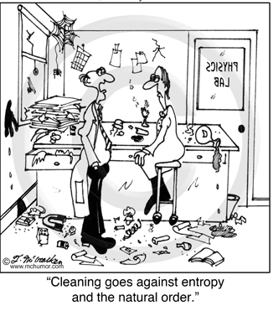
Second Law of Thermodynamics:
All changes either directly or indirectly increase the entropy of the universe.

Slide 25
Third Law of Thermodynamics:
The entropy of a perfectly ordered crystal is zero at 0 K.

Slide 26
Standard Entropy Sº: the entropy change between 0 K and 298 K (i.e.25ºC)
H₂O_{(l)} H₂O_{(g)} O_{2(g)}
1) All elements possess entropy
2) Units are in J/mol∙K
3) Entropy is temperature dependent (Enthalpy is not)
4) Unlike ΔH_{f} , entropy values listed are not the change in entropy for a formation reaction but simply what the substance possesses

Slide 27
Standard Entropy Change: ΔSº
ΔSº = Σn Sº_{P} - Σn Sº_{R}
C₃H_{8(g)} + 5O_{2(g)} → 3CO_{2(g)} + 4H₂O_{(l)}

Slide 28
