Slide 1
Thermochemistry
the study of the transfer of energy between reacting chemicals and their surroundings

Slide 2
Energy
the ability to do work OR the capacity to produce change
measured in J or kJ
Has many forms but the 2 main forms are potential energy and kinetic energy

Slide 3
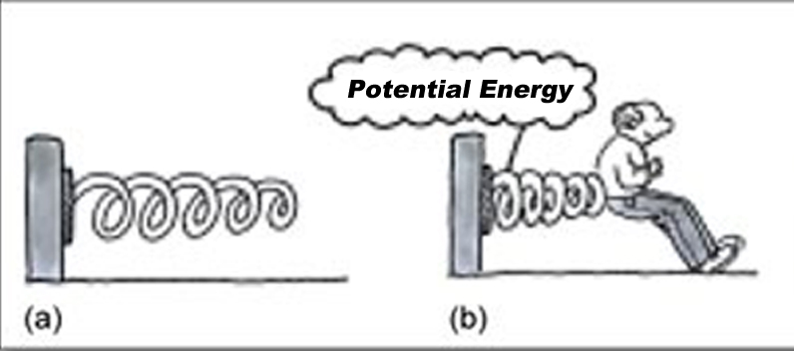
Potential Energy
-the energy possessed by a body because of its position (stored energy)

Slide 4
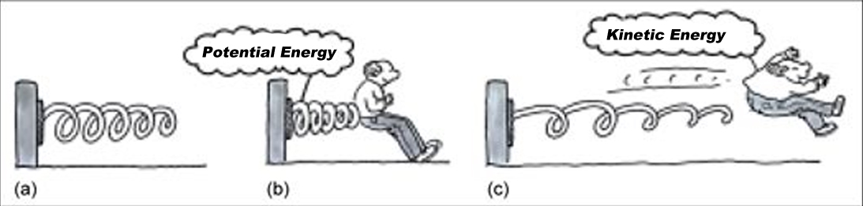
Kinetic Energy
-the energy of motion
-the greater the motion the greater the KE

Slide 5
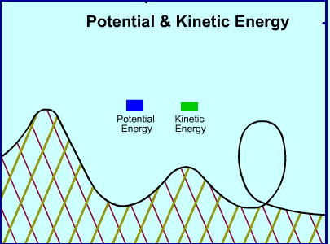
Potential energy can be converted to kinetic energy and vice versa

Slide 6
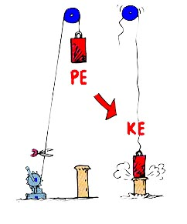
PE→KE

Slide 7
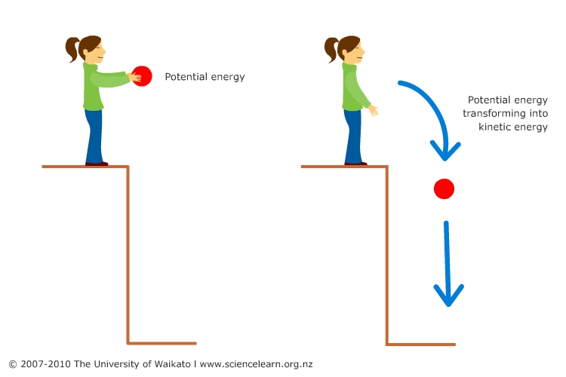
PE→KE

Slide 8
First Law of Thermodynamics
(aka Law of Conservation of Energy)
Energy can neither be created nor destroyed but may be converted from one form to another

Slide 9
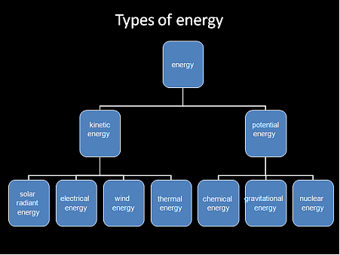
In theory, all forms of energy can be converted from one form to another

Slide 10
Chemical Energy
Is a form of potential energy because it is based on the position of atoms in a substance
Different types of atoms and different arrangement of atoms results in the storage of different amounts of chemical energy
During a chemical reaction, chemical energy may be 1) stored 2) released as heat 3) converted to another form of energy

Slide 11
Thermal Energy
Is a form of kinetic energy
Is the energy associated with the random motion of atoms and molecules

Slide 12
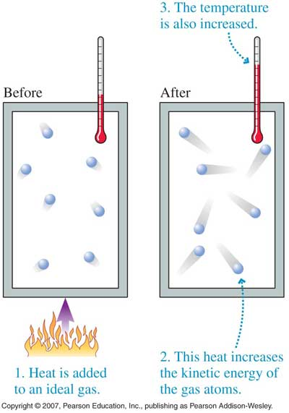
Thermal energy increases with temperature

Slide 13
Heat (q)
Is the transfer of thermal energy from one object to another due to temperature differences i.e. from a hot object to a cold object
An object possesses thermal energy but it does not possess heat
When referring to heat, i.e. the transfer of thermal energy, the terms “heat absorbed” and “heat released” are used

Slide 14
Temperature
Is proportional to the average kinetic energy of the particles of a substance i.e. the faster the particles move, the higher the temperature of the substance
In chemistry, temperature is measured in Celsius or Kelvin

Slide 15
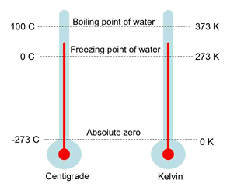
Converting from Celsius to Kelvin ºC +273= K

Slide 16
Thermal properties of substances describe the ability of a substance to absorb heat without changing chemically
a) Specific heat capacity (c)
is the amount of heat energy required to raise the temperature of 1 gram of a substance by 1ºC
Units: J/gºC
Unique for each substance
c_{water} = 4.18 J/gºC c_{Al} = 0.900 J/gºC

Slide 17
Example 1: How much heat is required to raise the temperature of 3.0 g of water by 10.0ºC?
q = mcΔT

Slide 18
Example 2: How much heat is released when 10.0 g of aluminum cools down by 5.0ºC?
q = mcΔT

Slide 19
Thermal properties cont’d
b) Heat capacity (C)
The amount of heat energy required to raise the temperature of a given quantity of a substance by 1 ºC
C = mc
Example 3: What is the heat capacity of 15 g of water?

Slide 20
Is most often used in the equation: q = CΔT
Example 4: How much heat is required to raise the temperature of a substance with a heat capacity of 5.0 kJ/ºC?

Slide 21
Some more terminology:
System: the components of a chemical reaction i.e. the reactants/products
2Na + 2H₂O→ 2NaOH + H₂
Surroundings: everything outside of the system i.e. the beaker the sodium and water are sitting in, the air

Slide 22
More terminology cont’d
Open system: matter and energy can move in and out
Closed system: matter cannot move in and out, but energy can
Isolated system: neither matter or energy can move in or out

Slide 23
More terminology cont’d
Exothermic Reactions: chemical reactions that produce heat; that is, heat is released from the system to the surroundings OR energy flows out of the system and into the surroundings
Endothermic Reactions: chemical reactions that absorb heat; that is, the surroundings supply heat to the system OR energy flows out of the surroundings into the system

